Slide 1
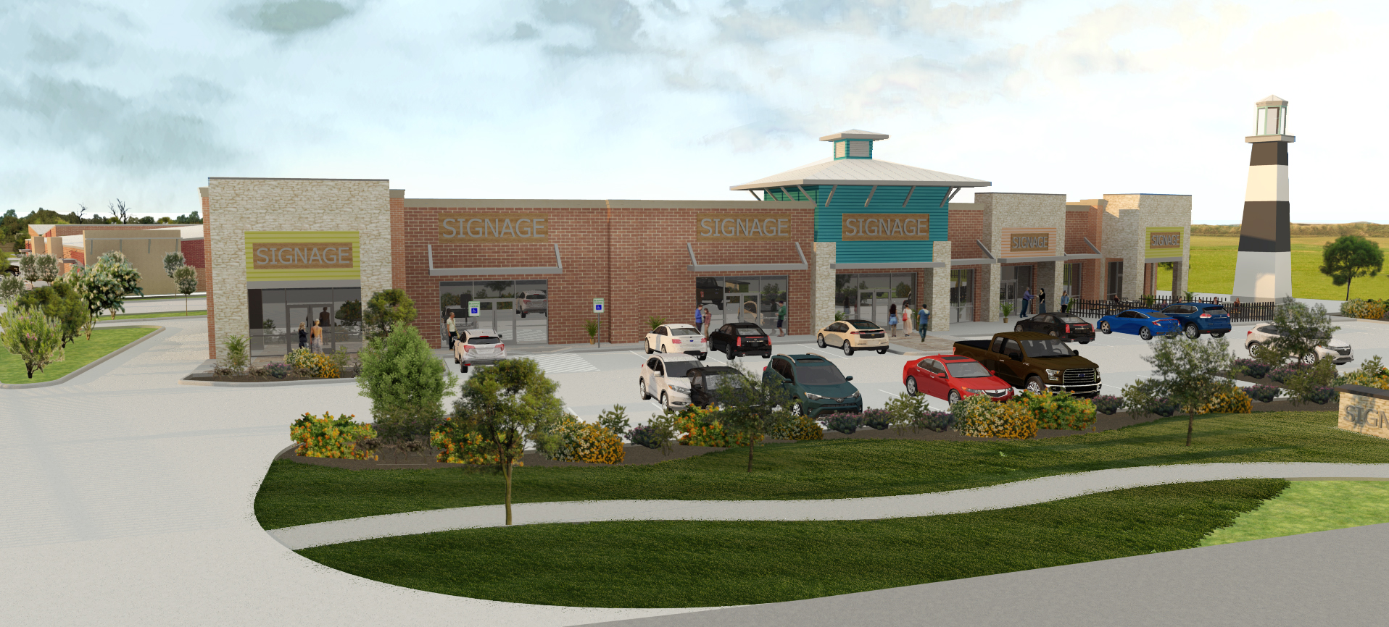
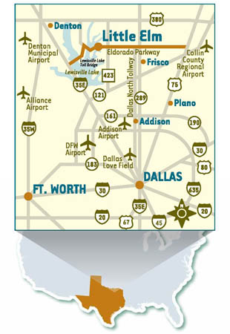
Lakeside Shops and Business Park, LLC
Planning for 10,800 feet retail/restaurant
Office warehouse space designed at 43,000SF

Slide 2
Property Highlights
Located on the west side of Little Elm-Targeted as the next growth market for the city
Positioned slightly off a major intersection of Eldorado and Highway 720. Three miles from the Lake Lewisville Toll Bridge that connects east and west Denton County and five miles south of highway 380
Presently heavy new home construction in five-mile radius with over 5,000 units planned
Recent Little Elm West Side Study lays nearby city uses which bolster Mixed Use Residential. https://www.dropbox.com/sh/ltuebgfhxn5l7w6/AABi2WPXw3wQtpbRQgoAkKTYa?dl=0
New Walker Middle School opened on Eldorado with 2,000 students. Walking distance
All buildings will have 100% brick elevations
All Buildings have 100% HVAC- Premium rent for conditioned space
Office spaces range from 2,000 to 5,000SF
Security and Gated Property in rear

Slide 3
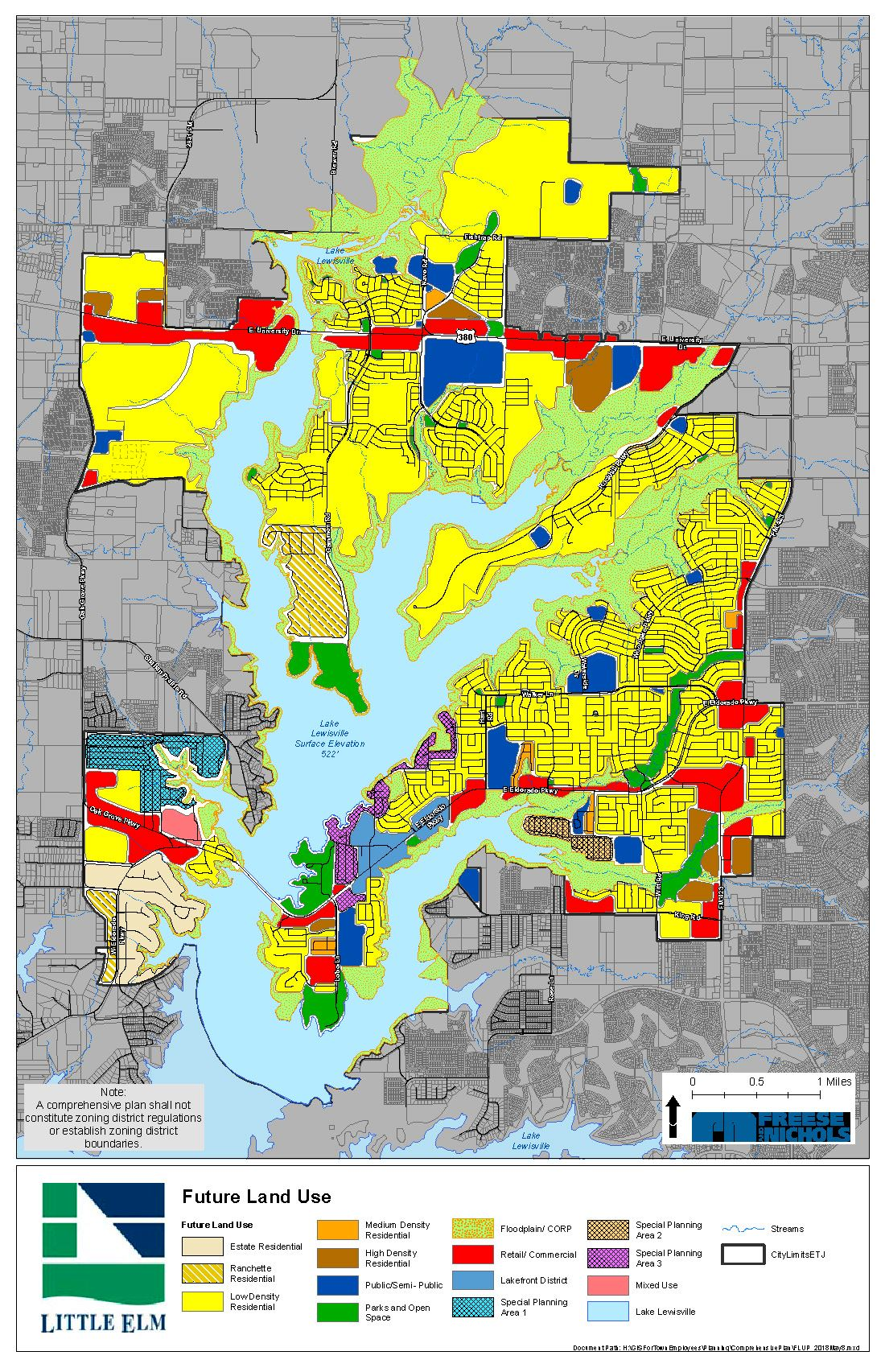
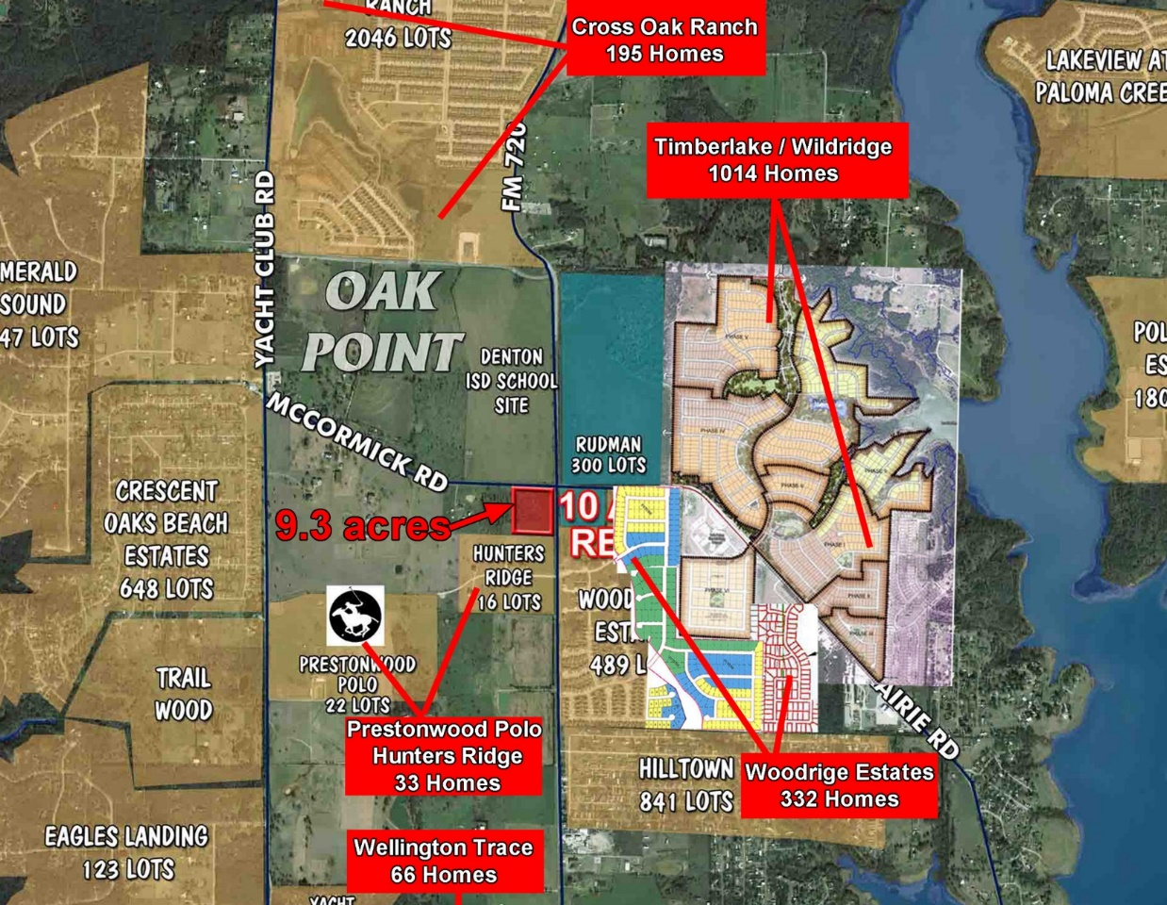
Hwy 720 Corridor (Eldorado to Hwy 380) North of Subject project

Slide 5
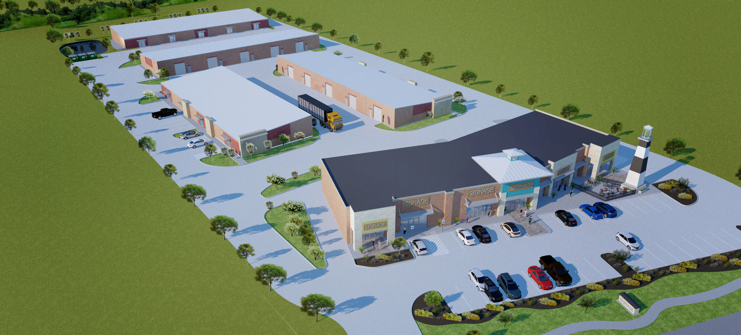
Drive Thru Included and retail approx. 11,200SF
E
D
C
B
A

Slide 7
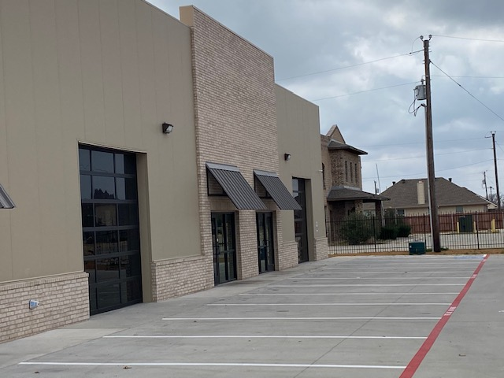
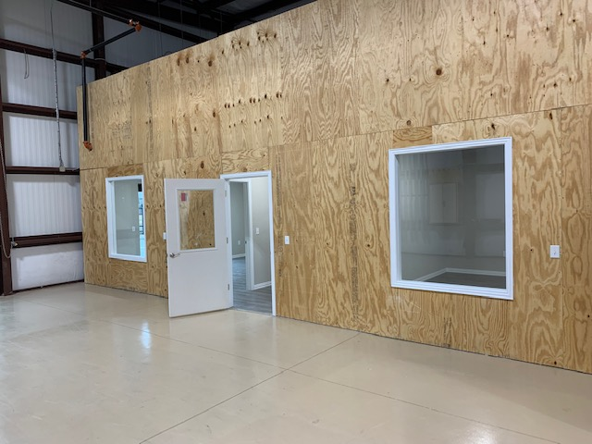
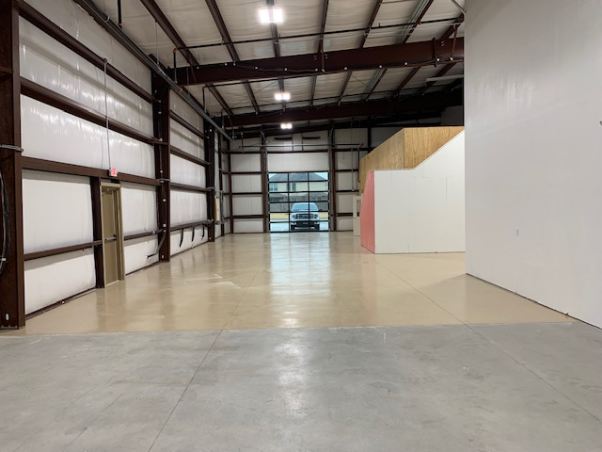
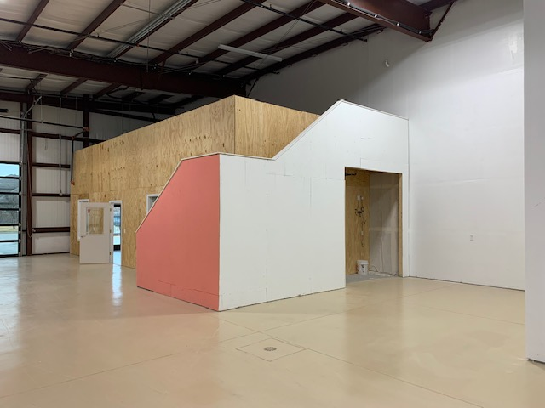
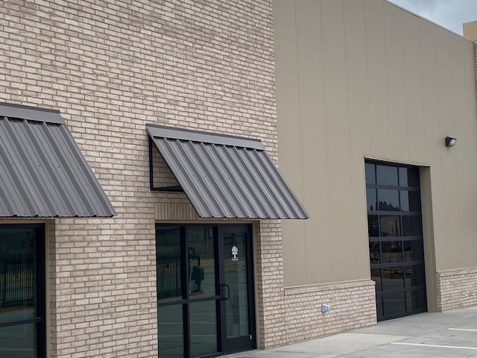
Project Examples

Slide 8
Building B Floor Plans

Slide 9
Building C Floor Plans

Slide 10
Building D Floor Plans

Slide 11
Building E Floor Plan

Slide 12
Hwy 720 Corridor (Eldorado to Hwy 380) North of Subject project

Slide 14
Drive Thru Included and retail approx. 11,200SF
E
D
C
B
A

